Slide 1
Neutrons on a surface of liquid helium.
A. Grigoriev⁺ , P. Grigoriev*, O. Zimmer** and T. Timman**
⁺Samara State University, Russia;
* L. D. Landau Institute for Theoretical Physics, Chernogolovka, Russia;
**Institute Laue-Laungevin, Grenoble, France.
Plan of the talk:
Introduction and motivation. Experiments with neutrons and their energy levels in the gravitational potential.
Neutrons on ideal surface of liquid helium.
Scattering of neutrons by atoms of helium vapor.
Scattering of neutrons by ripplons.
Scattering of neutrons by phonons and surfons.
Conclusion.

Slide 2
Neutrons on a flat surface
Introduction
The neutron potential energy as a function of distance from the surface:
The first excited state of the neutron
V(z)
The wave function of the neutron
n
The gravitational field of the Earth
Energy barrier
n
6µm
The lower level of the neutron
z
Substrate
Vacuum
Low-energy neutrons form bound states on a flat surface (discrete levels) with distance between the energy levels ΔE_{n}~1peV. Their kinetic energy along the surface K_{n}100neV.

Slide 3

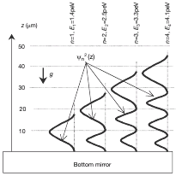
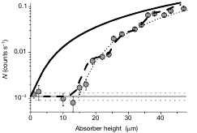
Measurement of surface levels of neutrons
Introduction
V. V. Nesvizhevsky and etc., «Quantum states of neutrons in the Earth's gravitational field» , Nature 415, 297 (2002)
wave functions of surface neutron
(along the vertical z-axis)
scheme of experiment
the measurement result

Slide 4
Our idea: to study the neutrons above the surface of liquid helium
Benefits:
1. Pure surface, without impurities.
2. Always strictly perpendicular to gravity
3. Much cheaper than silicon mirrows
4. Helium 4 does not absorb neutrons
Objective:
Theoretical estimates of the mean scattering time of neutrons on a helium surface due to the interaction with helium vapor atoms, ripplons, phonons, surfons and other excitations..

Slide 5
Liquid helium
Introduction
Helium - the only existing liquid at T = 0. The boiling point ⁴He T₄=4.2K, ³He T₃=3.2K. This is most pure liquid, as all impurities are attracted to and deposited on the walls and on the substrate under the action of van der Waals forces. There is only one type of excitation - ripplons (quanta of surface waves).
The concentration of the vapor atoms He is very small at low temperature:
The dispersion law of ripplons
vapor helium
He
He
He
Where the density of He⁴:
d – fluid depth
(He film thickness),
liquid helium
substrate
the surface tension

Slide 6

Evaluation of neutron scattering time
Matrix elements of the interaction are small, so the the probability of scattering of neutrons per unit time is determined by second order perturbation theory (by the Fermi's golden rule):
For each type of surface excitations we first calculate the matrix element of interaction F_{fi} and then integrate with respect to initial and final states.
There are two problems: (1) infrared divergence for scattering by ripplons (surface waves) => (2) is required to accurately determine the interaction matrix element, and the spectrum and wave functions of the neutron on the surface of helium.

Slide 7

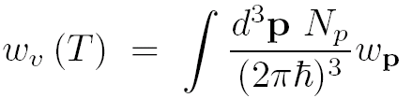
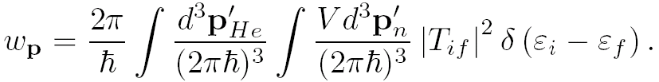

Calculation of scattering by helium vapor a common approach is simple
The interaction of the neutron with an atom is point-like (because of small size of the nucleus). Therefore, the matrix element does not depend on the momentum transfer and is known from the scattering amplitude:
The scattering rate by helium vapor atoms
Where the scattering probability per unit time by vapor atoms of a neutron with momentum p with given M_{He}=4M_{n}

Slide 8
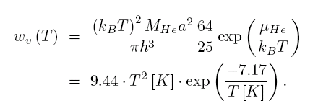
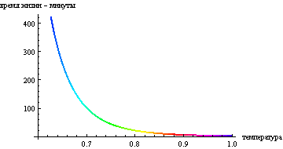
The rate of neutron scattering on a helium vapor (the result)
τ [min]
The temperature dependence of the neutron lifetime at the surface level due to scattering by vapor atoms
Thus, scattering by helium vapor does not hinder the neutron lifetime measurement already at
T ≤ 0.7 K.
T [K]

Slide 9

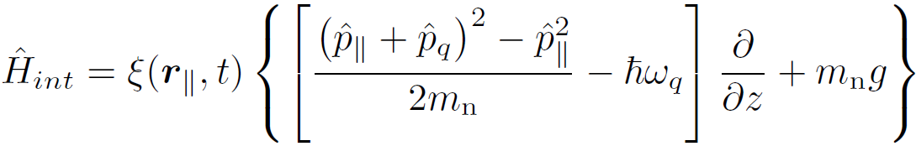

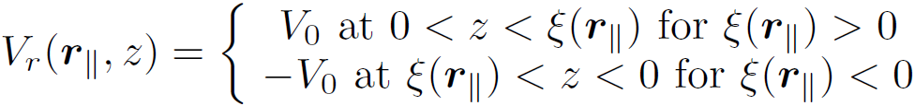
Neutron-ripplon interaction
The displacement of helium surface:
There are two limits: (1) adiabatic (neutron be in time to adapt to fluctuations of the surface), and (2) diabatic.
(1) In the adiabatic limit the interaction is associated with the addition to the kinetic energy of a neutron because of the movement of the border:
where
and
- neutron momentum and
ripplon momentum.
(2) The diabatic limit the interaction is related to addition to the potential energy of a neutron because of changes of the barrier shape V₀:
The matrix elements of the Hamiltonians (1) and (2) equal at ω_{q}~1kHz

Slide 10

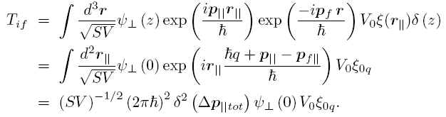
The matrix element of the neutron-ripplon interaction
The addition to the potential energy of the neutron
The ripplon amplitude is small, <1nm, and the size of the neutron wave function z₀=6μm, therefore, this potential approximately equal
The matrix element of the neutron-ripplon interaction for transitions to the continuous spectrum in the diabatic limit:

Slide 11






Calculation of scattering by ripplons
The matrix element of neutron-ripplon interaction
The rate of ripplon absorption:
where p_{q} – ripplon momentum and
distribution function of ripplons
The rate of ripplon emission :
where

Slide 12


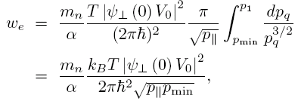
Calculation of scattering by ripplons (2)
Evaluating the integrals, we obtain for the absorption of ripplons
for the emission of ripplons
! These integrals diverge at small momentum of ripplons p_{q} :
The main contribution to this integral comes from small momentum
(infrared divergence)

Slide 13
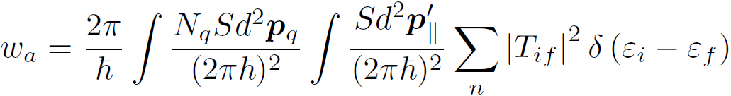
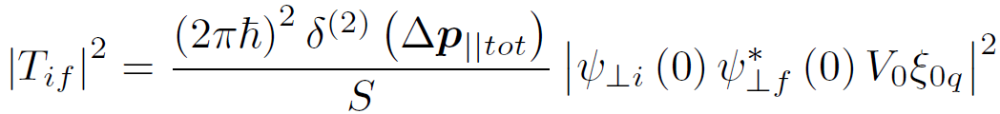
The scattering rate of neutrons by ripplons: solution to the problem of infrared divergence
The absorption rate of ripplon is given by inegral by the initial and final states:
The matrix element of the scattering of neutrons by ripplons:
If the change in neutron energy along the z-axis greater than the barrier V₀ , then the new state ψ _{⊥f} and its energy E_{n} belong to the continuous spectrum, and can be approximated by a plane wave. In the opposite limit (where we have the divergence of the integral), it is necessary to take into account the discrete spectrum and the wave functions of the bound states.
For transitions of neutrons to the discrete spectrum, infrared divergences is not appears!

Slide 14

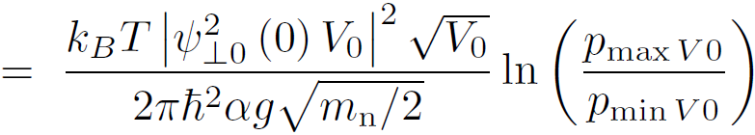
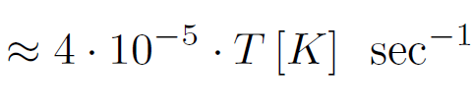


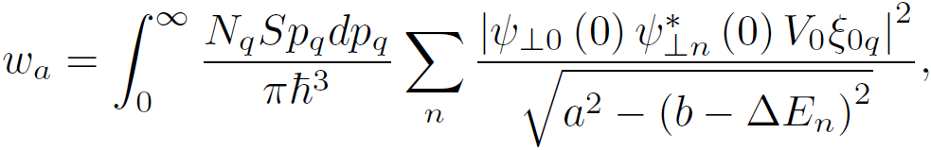
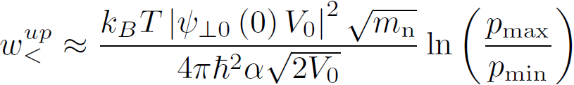

The upper bound of rate of ripplon absorption (result)
1. For transitions of neutrons to the discrete spectrum:
where
and
determined by the condition of reality of the square root in the denominator w_{a}:
where
2. For transition to the to the continuous spectrum main contribution is the infrared divergence in square root, but this infrared divergence is cut off at V₀ :

Slide 15
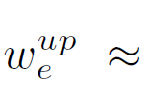
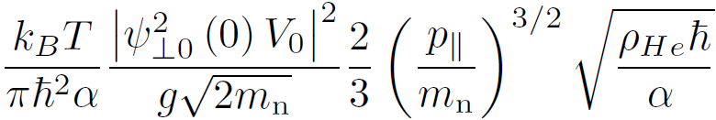

The upper bound of rate of ripplon absorption and emission (result)
The upper bound of rate of ripplon absorption :
The upper bound of rate of ripplon emission :
p|| - the initial momentum of the neutron along the surface
Substituting constants and the characteristic parameters of the system, we get the full scattering rate:
At T = 1K the rate of neutron scattering by ripplons
~ 3 hours and inversely proportional to temperature

Slide 16
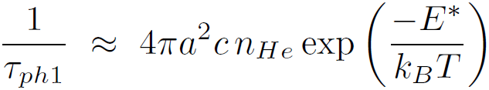
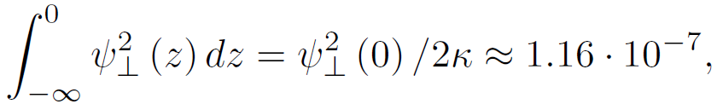

The scattering of neutrons by the surface phonons gives a very small contribution
1. Time neutron scattering in the volume of liquid helium τ_{ph0}≈100 seconds at Т=1К [R.Golub, Phys. Lett. A, 72, 387 (1979)]
neutron wave functions
где E*=2m_{n} c_{s}²≈14K
z
But, surface neutrons are almost over liquid helium: the depth of their penetration to ⁴He 1/κ=33nm, and the height of neutrons above the helium z₀=6000nm.
Vacuum
Therefore, the integral of the overlap
is very small:
n
n
liquid helium
Time neutron scattering surface by bulk phonons in helium high:
substrate

Slide 17
Another source of neutron scattering surface :
Atoms on the surface quantum level (surfons)
The temperature dependence of the surface tension Δσ (T) of both He isotopes can be explained if introduce a new type of excitations – surfons.
Surfons appear because there is a bound state of an atom at the surface, which has lower energy than He vapor and can propagate along the surface
He
He vapor
He
He
Surfons
He
He
He
liquid helium
Substrate
[1] A.M. Dyugaev, P.D. Grigoriev, JETP Lett.78(7), 466 (2003).
[2] P.D. Grigoriev, A.M. Dyugaev, E.V. Lebedeva, JETP 104 (1), p. 1-10 (2008)
[3] P. D. Grigor’ev, A. M. Dyugaev and E. V. Lebedeva, JETP Lett. 87, 106 (2008)
[4] A.D. Grigoriev, A.M. Dyugaev, P.D. Grigoriev, J. Low Temp. Phys. 163, 131–147 (2011)
[5] А.Д. Григорьев, П.Д. Григорьев, А.М. Дюгаев, А.Ф. Крутов, ФНТ 38, 1274 (2012)

Slide 18
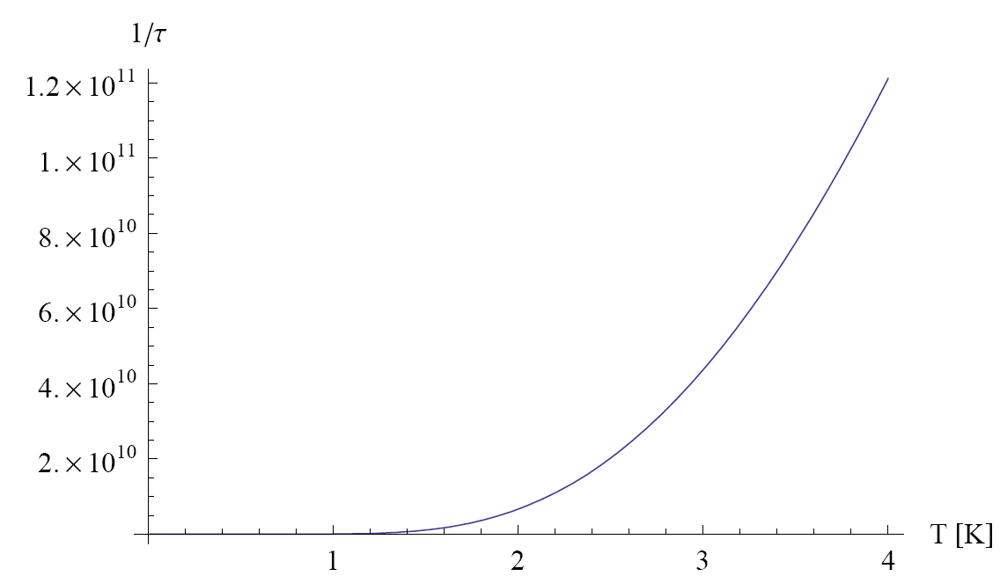
Surfon is a quasiparticle with Γ<< E.
Two channels limit the surfon-quasiparticle lifetime: (1) merging into the liquid and (2) evaporation.
V(z)
1) to merge into the bulk the surfon must
(a) overcome the potential barrier;
(b) push away other atoms.
Therefore, the surfon level width Γ<< E.
Vacuum
He
z
7.17K
potential energy of atom above He
2)
Surfon evaporation rate as function of its in-plane momentum at T =1.5K
Average surfon evaporation rate as function of temperature
At T~1K the evaporation rate ~3•10⁸ sec⁻¹, => level width Γ=0.0022K

Slide 19
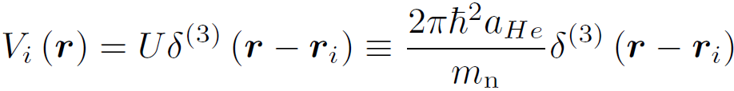
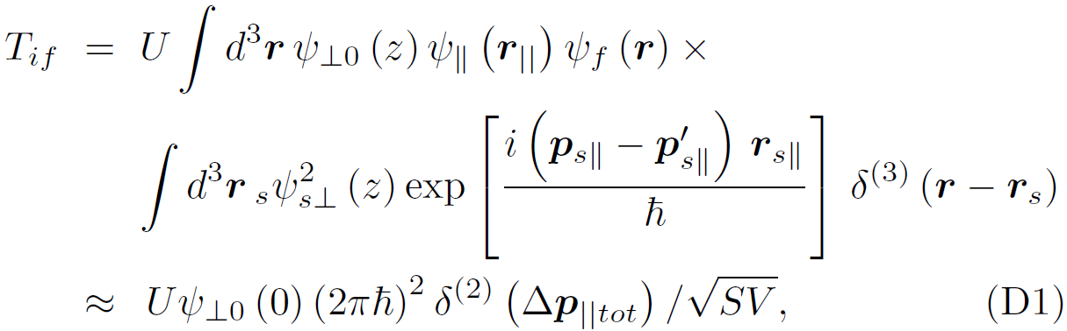
Scattering of neutrons by surfons (1)
The potential is the same, as for scattering on helium vapor
but the He atom + neutron out-of-plane momentum is not conserved,
because the surface violates spatial uniformity.
The matrix element conserves only the in-plane total momentum:
and

Slide 20
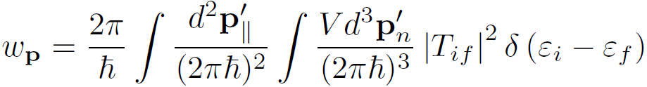
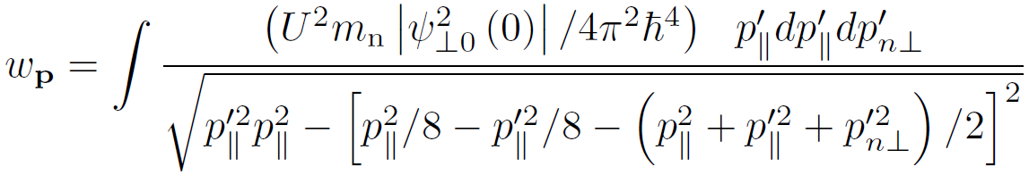
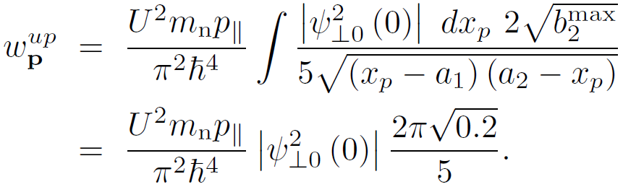
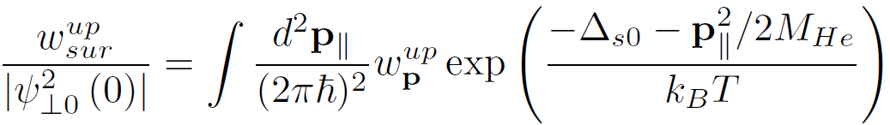
Scattering of neutrons by surfons (2)
Scattering rate of a neutron by a surfon with initial in-plane momentum p
is given by the golden Fermi rule:
The integration over the in-plane momentum and angle gives at M=4m_{n}
The upper estimate of this integral gives
The total scattering rate of neutrons by surfons is given by

Slide 21
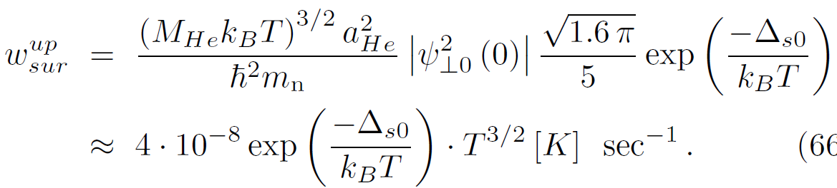
Scattering of neutrons by surfons (result)
The upper estimate of neutron-surfon scattering rate
z
where the surfon excitation energy above liquid ⁴He is Δ_{s0} ≈ 3K.
Vacuum
n
Such small value of the neutron scattering rate by surfons as compared to He vapor is because of the small value of the neutron wave function at the surface, where the surfons reside.
liquid helium
substrate

Slide 22
The planned experiment
By group of O. Zimmer at Institute Laue-Laungevin, Grenoble, France
neutron wave functions
The calculations showed that the scattering time of ultracold neutrons above liquid helium surface is large (more than one hour) at T<0.6K, when the vapor concentration is low.
z
Superfluid helium more convenient because it completely covers the wall of the vessel, which reduces the absorption of neutrons on the walls of the vessel.
Vacuum
n
n
To avoid possible problems with the scattering of neutrons by the meniscus and by the vessel walls (it is not yet calculated theoretically), it is also planned to locate the neutrons along the surface by an inhomogeneous magnetic field using magnetic coils in the substrate.
liquid helium
substrate

Slide 23
Conclusion
We studied the bound states of ultra-cold neutrons in the gravity potential above the surface of liquid helium 4;
We estimated the scattering time of surface neutron in these bound states by helium vapor, by ripplons and also by phonons and surfons. At T = 0.8K the scattering time is comparable with neutron lifetime ~15 minutes.
The resulting scattering time is large and allows to measure the neutron lifetime at low helium temperature;
The main contribution to the scattering of ultracold neutrons comes from helium vapor and ripplons. The concentration of these excitations rapidly decreases with temperature. So the measurement of the neutron lifetime on the liquid helium surface is possible, but effective only at low temperatures. At T <0.6K time of the scattering of neutrons above the surface by the surface excitations exceed 2 hour.

Slide 24
Conclusion
We studied the bound states of ultra-cold neutrons in the gravity potential above the surface of liquid helium 4;
We estimated the scattering time of surface neutron in these bound states by helium vapor, by ripplons and also by phonons and surfons. At T = 0.8K the scattering time is comparable with neutron lifetime ~15 minutes.
The resulting scattering time is large and allows to measure the neutron lifetime at low helium temperature;
The main contribution to the scattering of ultracold neutrons comes from helium vapor and ripplons. The concentration of these excitations rapidly decreases with temperature. So the measurement of the neutron lifetime on the liquid helium surface is possible, but effective only at low temperatures. At T <0.6K time of the scattering of neutrons above the surface by the surface excitations exceed 2 hour.
Thanks for attention!

